Slide 1
Capstone Engagement Assessment, Analysis, and Hardening of a Vulnerable System

Slide 2
Table of Contents
This document contains the following sections:
Network Topology
01
02
Red Team: Security Assessment
03
Blue Team: Log Analysis and Attack Characterization
Hardening: Proposed Alarms and Mitigation Strategies
04

Slide 3
Network Topology
<number>

Slide 4
Network Topology
[Insert Here]
Use draw.io to create a diagram of the network.
Add your diagram to this slide and fill out the data in the sidebar.
Network
Address Range:
192.168.1.0/24
Netmask:
255.255.255.0
Gateway:
Machines
IPv4: 192.168.1.1
OS: Windows
Hostname: Windows Azure Environment
IPv4: 192.168.1.90
OS: Kali
Hostname: Kali
IPv4: 192.168.1.105
OS: Apache/2.4.29 Server
Hostname: Capstone
IPv4: 192.168.1.100
OS: Vagrant
Hostname: Elk

Slide 5

Red Team Security Assessment
<number>

Slide 6
Recon: Describing the Target
Nmap identified the following hosts on the network:
Hostname | IP Address | Role on Network
Windows Azure Lab Environment | 192.168.1.1 | The azure environment housing all machines
Kali | 192.168.1.90 | The offensive machine targeting Capstone
Capstone | 192.168.1.105 | This machine houses the WebDAV server
Elk | 192.168.1.1000 | This server monitors and logs all traffic to and from Capstone

Slide 7
Vulnerability Assessment
The assessment uncovered the following critical vulnerabilities in the target:
Vulnerability | Description | Impact
Open HTTP port | This allows open access to the open directory | With the port being so easily found by nmap, this provides a point of ingress for attackers
LFI Vulnerability | LFI allows access into confidential files on a site. | An LFI vulnerability allows attackers to gain access to sensitive credentials
Password Strength | A weak password allows for brute force attacks to be easily achieved. | With an easy password to crack, there’s no limit to what an attacker can access.
Remote Code Execution | This allows a malicious code to be uploaded into the machine. | With a backdoor access, a shell command can be executed

Slide 8
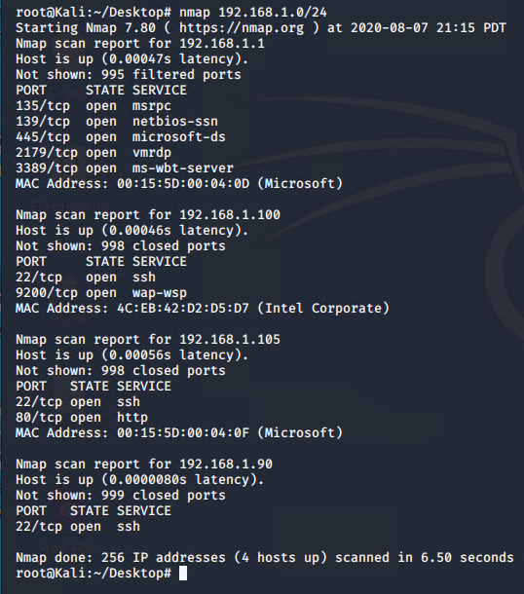
Exploitation: Nmap Scanning
01
02
03
Nmap 7.60
An open source tool that scans for open ports in a network.
Nmap 192.168.1.0/24
Achievements
Nmap scanning showed a vulnerable HTTP port that an attacker can use to access capstone machine.

Slide 9
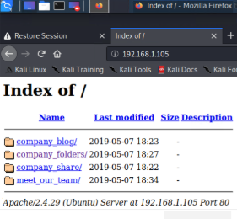
Exploitation: Local File Inclusion
01
02
03
Tools & Processes
Port 80 was initially discovered by nmap scan. The local file inclusion is a completely open directory that shouldn’t be publicly accessible.
Achievements
With access, an attacker can browse and access, potentially, sensitive files.

Slide 10
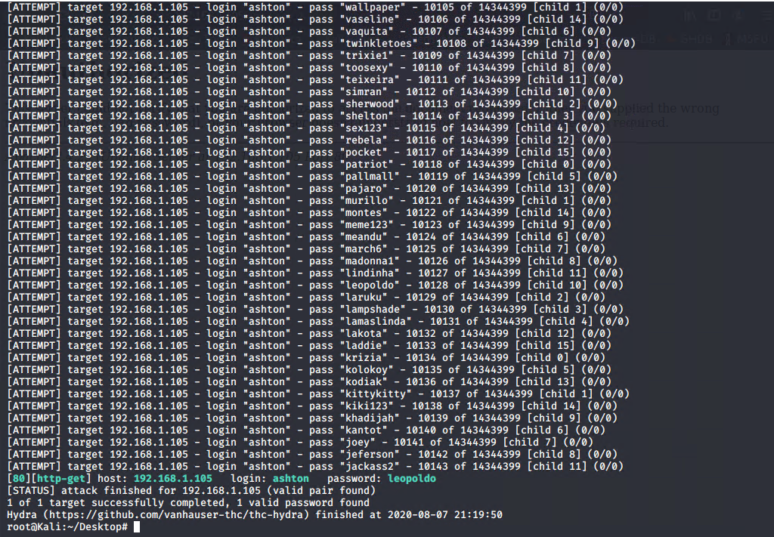
Exploitation: Brute Force of a Weak Password
01
02
03
Hydra:
Hydra is a tool that brute forces a login with a provided wordlist to provide a password for the attacker.
Achievements
After learning of the username from the LFI, Hydra provided the password ‘leopoldo’ to log into the secret folder. Within the secret folder, there were instructions on how to access the webDAV.

Slide 11

Blue Team Log Analysis and Attack Characterization
<number>

Slide 12

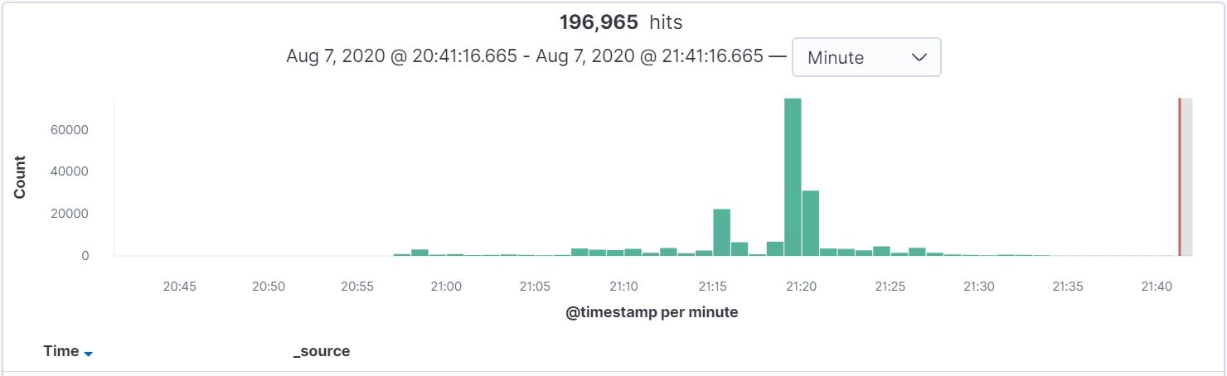
Analysis: Identifying the Port Scan
The scan was started at 9:19 pm
Approximately 69,000 packets were sent from 192.168.2.90
The huge spike in network activity coincide with the spike of packets sent from 192.168.1.90

Slide 13
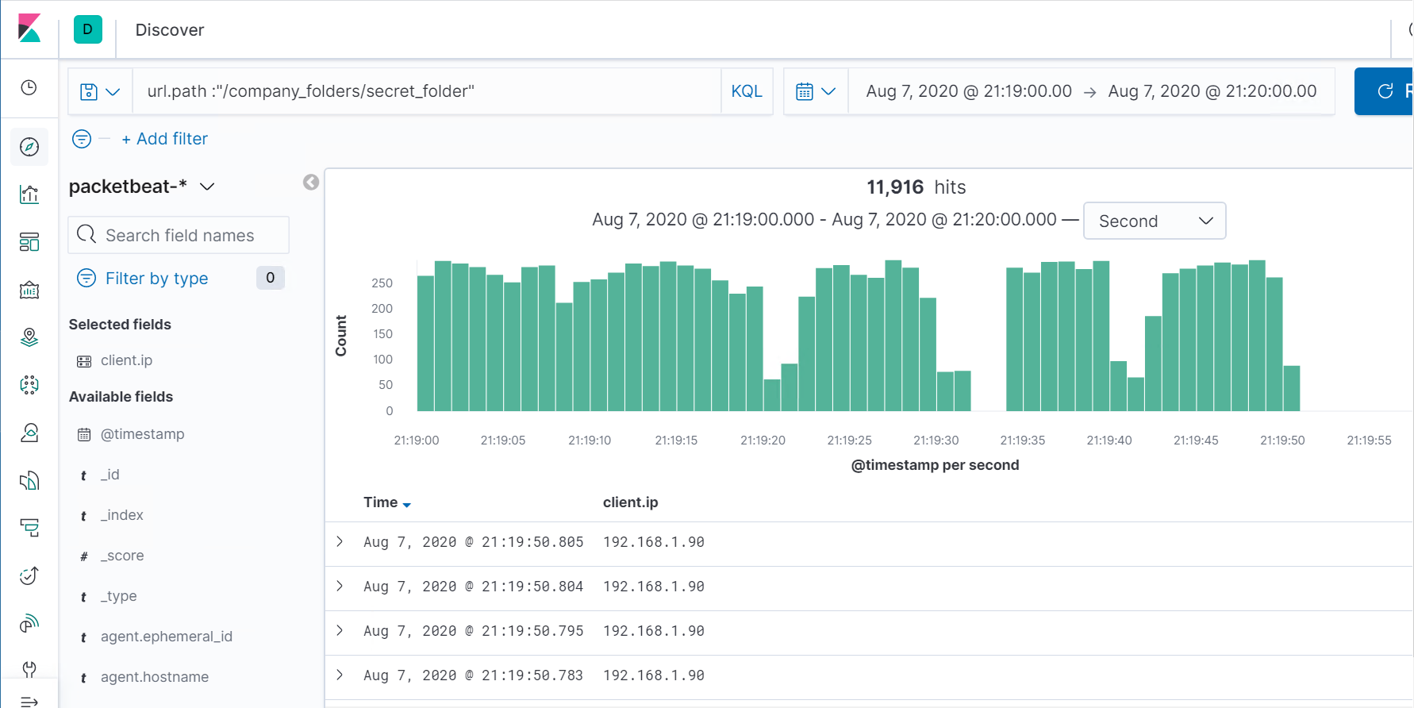
Analysis: Finding the Request for the Hidden Directory
The requests were made starting at 21:19 with just under a total of almost 12,000 requests.
The requested file was /company_folders/secret_folder/connecting_to_webdav
This file contained instructions with how to access the webdav.

Slide 14
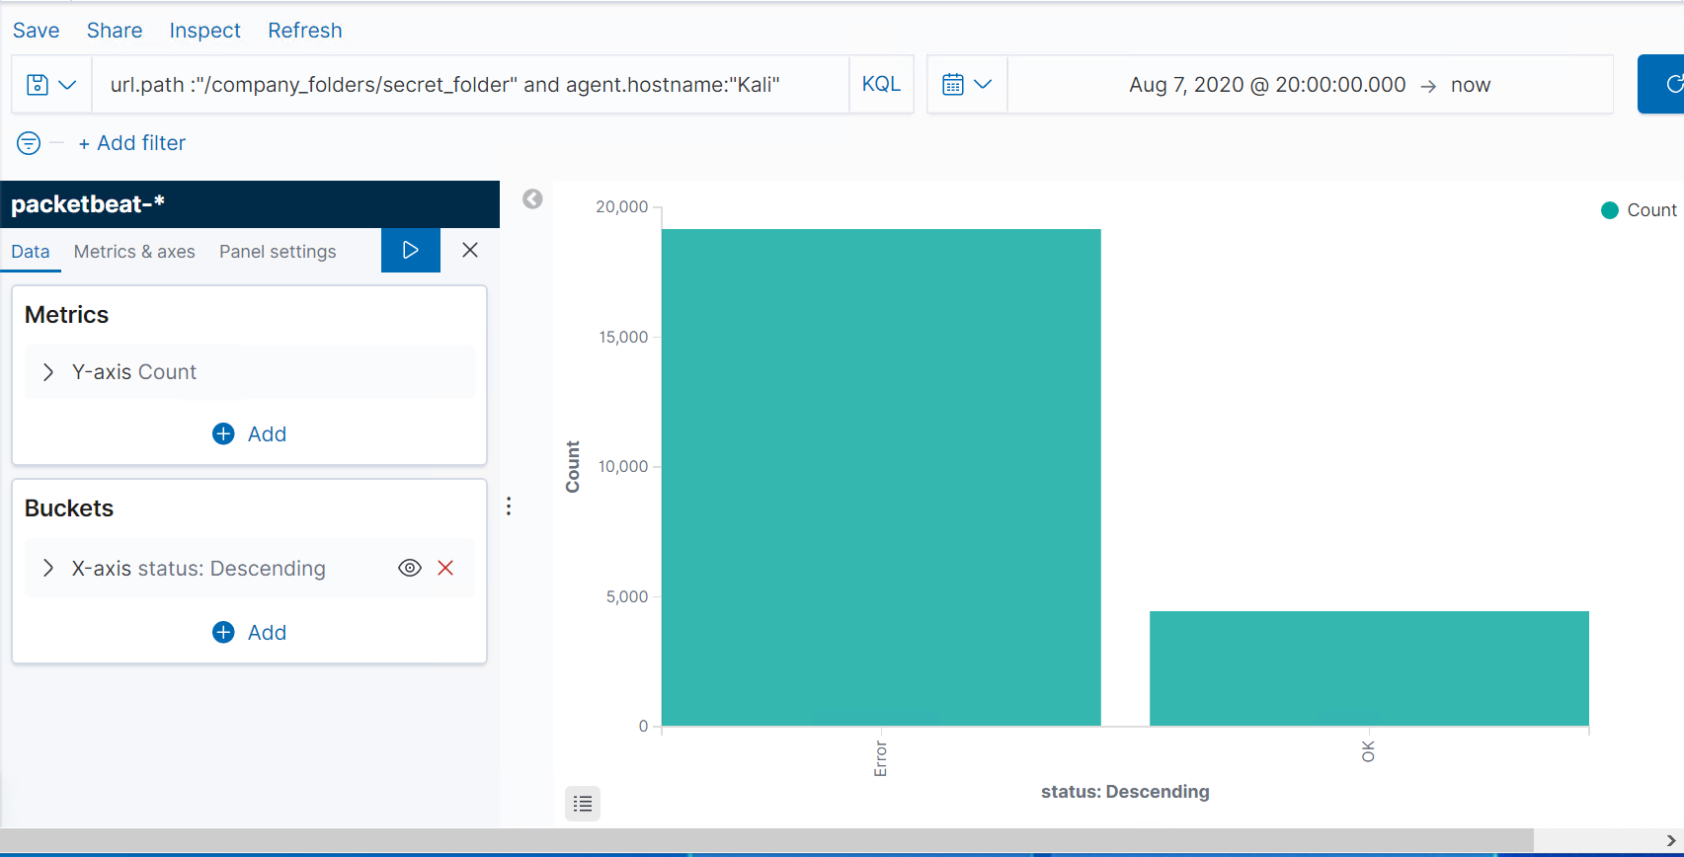
Analysis: Uncovering the Brute Force Attack
- Just over 23,000 requests were made to the secret folder
- A total of 19,138 attempts were landed in errors before successfully being able to log in with the compromised password

Slide 15
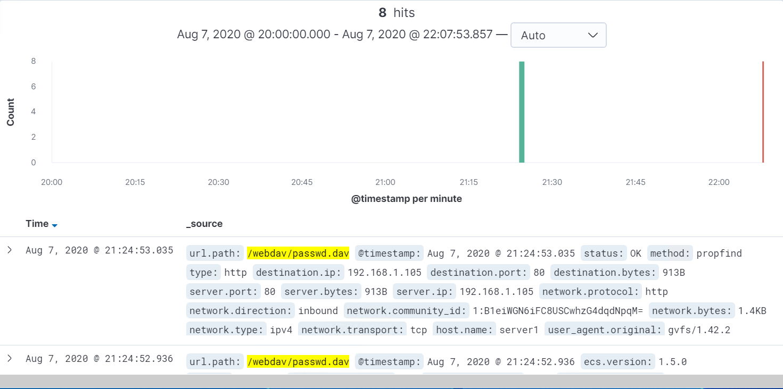
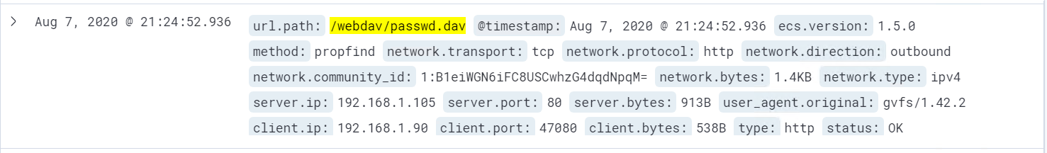
Analysis: Finding the WebDAV Connection
A total of 8 attempts were made
The requested file was passwd.dav

Slide 16
Blue Team Proposed Alarms and Mitigation Strategies
<number>

Slide 17
Mitigation: Blocking the Port Scan
What kind of alarm can be set to detect future port scans?
- There should be an alarm set for a SYN/ACK requests that exceeds the threshold
What threshold would you set to activate this alarm?
- Baseline : 10-15 threshold
- Threshold: 25
What configurations can be set on the host to mitigate port scans?
- Having only the necessary ports open.
- Sanitize and whitelist IP addresses for specific ports
- Firewall settings on ports for inbound traffic.

Slide 18
Mitigation: Preventing Brute Force Attacks
What kind of alarm can be set to detect future brute force attacks?
- An alarm should be set for login failures and be sent to security employees.
- The Log in failure baseline should be 5 and the threshold should also be set to 5
What configuration can be set on the host to block brute force attacks?
- A secure password policy should be in place.
- There should be a lock out policy for log in failures after exceeding the threshold.
- Multi Factor Authentication
- Time based User Lockouts

Slide 19
Mitigation: Detecting the WebDAV Connection
What kind of alarm can be set to detect future access to this directory?
- An alarm should be set for any “GET” requests on files within the directory
What threshold would you set to activate this alarm?
The baseline for “GET” request on outbound files should be bound to a limit of 1.
What configuration can be set on the host to control access?
- Whitelisting authorized IP addresses
- There should be user privileges for accessing the webDAV.

Slide 20
Mitigation: Identifying Reverse Shell Uploads
What kind of alarm can be set to detect future file uploads?
- Set alarm for any PUT and POST http requests for .php file uploads
What threshold would you set to activate this alarm?
- There should be a threshold of one considering the dangers of even one being in the system
What configuration can be set on the host to block file uploads?
- Enable only read and write for user permissions
- Disable .php uploads from IP addresses that aren’t whitelisted
-

